Slide 1
GED® 101
An Introduction to the
GED® Program and Test
Ann Evers
September 24, 2019

Slide 2

Notes:
Key Points
Welcome participants and provide a brief introduction of yourself.

Slide 3
Getting to know you!
Who is at the GED International Summit for the first time?
Which countries are here today?
Which schools?
How many students are in your school (approx.)?
Who teaches all four content areas?
Math? RLA? Social Studies? Science?

Slide 4

Session Objectives
Explore key components and structure of the GED® test
Overview of the GED® test
Explore tools for the classroom
Provide an overview of content and key strategies
Share resources from the GED® Website
Notes:
Key Notes
Review the objectives of the session.

Slide 5

Setting the Stage
Background you should be familiar with and may share about the test.

Slide 6
Background
Content alignment
Test structure and forms equivalence
Constructed response items and scoring
Performance levels

Slide 7
Content Alignment
How is the GED® test aligned to specific content standards?
The GED® test was developed by design to reflect college and career readiness standards
  Crosswalks and external alignment studies demonstrate alignment between GED® Assessment Targets and CCR standards
  CCR standards are US-centric, but are still relevant to international audiences
  Standards from top-performing countries played a significant role in the development of the CCR standards.

Slide 8
Content Alignment
The underlying content standards are
  Research-based and evidence-based
  Clear, understandable, and consistent
  Aligned with college and career expectations
  Based on rigorous content and the application of knowledge through higher-order thinking skills
  Informed by international content standards

Slide 9
Test Structure and Forms Equivalence
The scale for each content test is 100 – 200 with passing set at 145
How many questions do my students need to get right to pass?
  We don’t share that information because it
    Differs slightly from form to form and
    Differs slightly by content area
  The minimum score for HSE requires around 40% of the total raw score points
    Remaining score points are distributed between 146 and 200 scaled score points

Slide 10
Test Structure and Forms Equivalence
What’s the difference between raw score points and scaled score points?
  Each content test has between 35 and 65 raw score points, roughly corresponding to the number of items
    RLA has the largest number of raw score points – it is two content areas in one (reading and writing)
    Test forms meet detailed blueprints and difficulty specifications
    Forms are very similar in raw score difficulty but rarely exact
  Transformation to “scaled scores” allows
    Comparability of test performance – test score represents same level of performance, no matter what form was taken

Slide 11
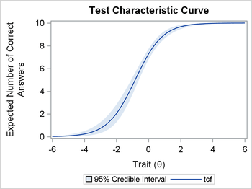
Test Structure and Forms Equivalence
How do I know that all test forms are
equivalent, when a student might
report that one form seems
harder/easier than another?
  Test forms all match same
  blueprint and specifications
  Test characteristic curves demonstrate the match across forms
  Content within each reporting category is “sampled”
    One form might have a content sample that is more or less familiar to a particular test-taker
    This may lead to different learner perceptions of the test, even though the test forms are equated

Slide 12
Performance Levels
The test has two performance levels
  Non-pass
  Pass (high school equivalency)
The ”Pass” level can be divided into 3 “sub-levels” for instructional purposes
  Pass, Pass+, Pass++
  We will share the detailed descriptors for these levels with you for use in instruction

Slide 13
Exploring the Program
Moving to the Future

Slide 14
  “To build the educated and employed communities
  of tomorrow…..
  ..…..one student at a time.”
GED® Program Goal
Notes:
So that’s a pretty lofty goal, so what does it really mean?
First, it means that we understood was a goal that we, as an organization, could not accomplish on our own.
From the beginning, we understood it to mean we must be a partner in the entire process, and draw upon the understandings that each community of adult education stakeholders had to offer

Slide 15
Purposes of the GED® test
To provide results leading to the award of a high school equivalency credential
To provide evidence of readiness to enter workforce training programs or postsecondary education
To provide actionable information about a candidate’s academic strengths and weaknesses
Notes:
Key Points
Purposes of the GED® assessment are to provide
a high school credential,
evidence of readiness to enter workforce training programs or postsecondary education, and
information about a candidate’s strengths and areas of developmental need.
As we look at the test, it’s important to remember that the purposes of the GED® assessment are 1) to provide a high school credential, 2) to provide evidence of readiness to enter workforce training programs or postsecondary education, and 3) to provide information about a candidate’s strengths and areas of developmental need.
To provide a high school credential. By measuring whether a candidate has acquired the foundational academic skills and knowledge deemed necessary for high school exit, the GED® assessment will provide an alternate pathway for adults who have not earned a high school diploma.
To provide evidence of readiness to enter workforce training programs or postsecondary education. The GED® assessment will measure whether a candidate is ready to enter a workforce training program or a typical entry-level, credit bearing 2- or 4-year college course without needing remediation.
To provide information about a candidate’s strengths and areas of developmental need. By providing more information about candidate proficiency on career and college readiness standards, potential employers, postsecondary advisors, and educators can help candidates strengthen those areas of developmental need so that the candidates are ready for the next level of lifelong education and training.
The new GED® assessment is future focused: that is, it is designed to provide information about candidate readiness that is directly tied to the next steps in their preparation and training.

Slide 16
A New Paradigm
Critical Thinking Skills: All content areas
Problem-solving Skills: All content areas
Close Reading Skills: All content areas
Evidence-based Writing Skills: Reasoning Through Language Arts
Notes:
Key Points
This test represents a new paradigm, one in which critical thinking, problem solving, and close reading skills are required across all content areas. In addition, with the inclusion of evidence-based writing, students are expected to demonstrate both their reading and writing skills. No longer is it acceptable to write an opinion piece, rather students have to analyze and evaluate text and develop a claim supported by evidence drawn from what they have read.

Slide 17
An Overview of the GED® Test
Getting Started
Notes:
Key Points
The next few slides provide a quick overview of the GED® test.

Slide 18
GED® Test
Test | Time | Notes
Reasoning through Language Arts | 150 minutes | 3 Parts Part 2 – 45 minutes for extended response (timed separately) and a 10 minute break
Mathematical Reasoning | 115 minutes | Part 1 – calculator not allowed; Part 2 – calculator allowed
Social Studies | 70 minutes
Science | 90 minutes
Notes:
Key Points
The chart provides an overview of the time for each of the tests, as well as pertinent notes.

Slide 19
GED® Performance Levels
1 Below Passing | 2 Pass / High School Equivalency
100-144 | 145-200
Scores below the GED® test Passing Standard | Scores at or above the GED® test Passing Standard indicative of High School Equivalency as well as increasing readiness for credit-bearing postsecondary coursework
Notes:
Key Points
What is the passing score for the GED® test? If test-takers score below a 145, they are below passing and must retake each test part in which they received the below passing score. In order to pass the GED® test, test-takers must earn a passing score of 145 or higher on each part of the four-part battery in order to receive their GED® test credential. Students can also earn the designation of GED® College Ready, scores of 165-174, or GED® College Ready + Credit, scores of 175-200, on their transcripts. These designations indicate that a student has skills that are indicative of college and career readiness or those skills taught in some beginning college-level courses.

Slide 20
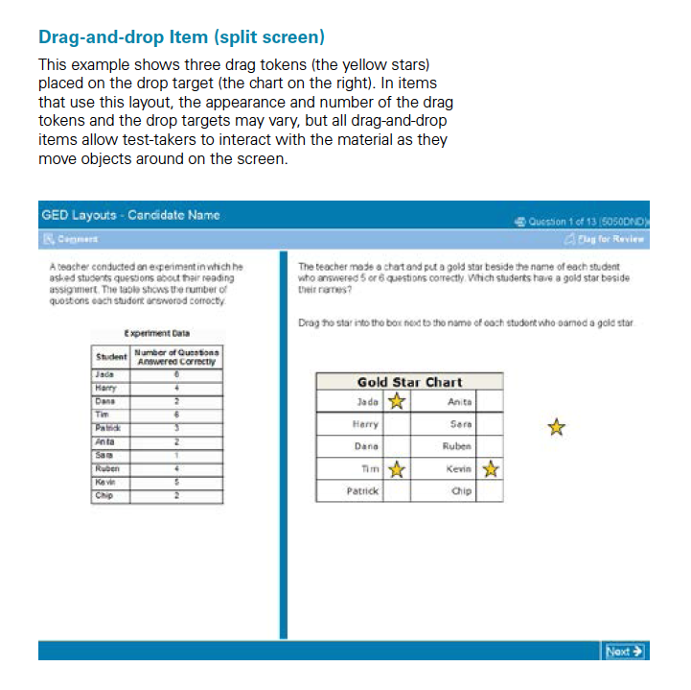
Item Types
Multiple choice
Technology-enhanced
  Fill-in-the-blank
  Hot-spot
  Drag-and-drop
  Drop-down selection
Extended response
Notes:
Key Points
Discuss the different item types on the new test. Share with participants that they will be spending time with two tutorials that will provide them with a better understanding of how the technology-enhanced items “look,” as well as an overview of different types of questions in each content area.

Slide 21

Overview of RLA Test
Content - Integrated reading and writing
  Close reading
  Clear writing
  Editing and understanding the use of standard written English in context
Source texts – 75% Informational; 25% Literary
Passage length – 400-900 words
Range of text complexity, including texts at the college- and career-ready level
Technology-enhanced items and extended response
Notes:
Key Points
This slide provides a short overview of the content and context of the RLA Test. Review the information on the slide. For additional information, access the Assessment Guide for Educators Reasoning through Language Arts section.

Slide 22
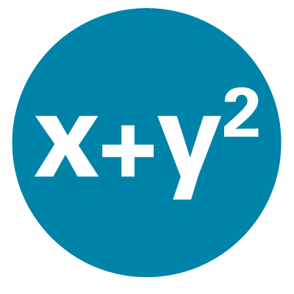
Overview of Mathematical Reasoning Test
Content
  45% - Quantitative Problem Solving
    Number operations
    Geometric thinking
  55% - Algebraic Problem Solving
Texas Instruments - TI 30XS Multiview™ (calculator allowed on most items
Integration of mathematical practices
Formula page, symbols, and calculator page provided
Notes:
Key Points
This slide provides a short overview of the content and context of the Mathematical Reasoning Test. Review the information on the slide. For additional information, access the Assessment Guide for Educators Mathematical Reasoning section.

Slide 23

Overview of Social Studies Test
Content
  50% - Civics and Government
  20% - United States History
  15% - Economics
  15% - Geography and the World
Themes
  Development of Modern Liberties and Democracy
  Dynamic Responses in Societal Systems
Social Studies Practices – analyzing, thinking, reasoning
Technology-enhanced question items
Notes:
Key Points
This slide provides a short overview of the content and context of the Social Studies Test. Review the information on the slide. For additional information, access the Assessment Guide for Educators Social Studies section.

Slide 24

Overview of Science Test
Content
  Life Science – 40%
  Physical Science – 40%
  Earth and Space Science – 20% Themes
Themes
  Human Health and Living Systems
  Energy and Related Systems
Science Practices – reasoning and thinking scientifically
Question types - Technology-enhanced items
Notes:
Key Points
This slide provides a short overview of the content and context of the Science Test. Review the information on the slide. For additional information, access the Assessment Guide for Educators Science section.

Slide 25
Important Tools for the Classroom
Reasoning through Language Arts, Mathematical Reasoning, Science, and Social Studies

Slide 26

From Targets to Indicators to Application
Assessment Targets describe the general concepts that are assessed on the GED® test
Indicators are fine-grained descriptions of individual skills contained within an assessment target
Application describes what to look for in student work
Assessment Guide for Educators
Notes:
Key Points
Targets – Indicators – Application.
If you remember from the initial resource guide for the GED® test, there are Assessment Targets which describe the general concepts that are assessed on the test. From there, we move to Indicators – much more fine-grained description of individual skills included within the assessment target.
However, the last piece may provide the greatest value to teachers – application or descriptions of what to look for in students’ work. It is that last piece that provides us with information that we can use to ensure we are providing students with the skills they need.

Slide 27
Example
Assessment Target | Indicators | What to look for in student work: The student has . . .
SP.2 Investigation Design (Experimental and Observational) | SP.2.b Identify and refine hypotheses for scientific investigations SP.2.e Identify and interpret independent and dependent variables in scientific investigations. | identified a hypothesis for a given scientific investigation. differentiated between an appropriate hypothesis and a poorly conceived hypothesis. used a hypothesis to support or challenge a given conclusion. identified a hypothesis for a given data set. refined a hypothesis to more appropriately suit a scientific experiment. identified the independent variable in a given investigation. identified the dependent variable in a given investigation. fully explained the relationship between the independent and dependent variables in a given experiment.
Notes:
Key Points
Let’s take an assessment target and look at the indicators, as well as the applications that we should be looking for in student work. The assessment target is Investigation Design (Experimental and Observational). However, what exactly does that mean? When we look at the indicators – Identify and refine hypotheses for scientific investigations and identify and interpret independent and dependent variables in scientific investigations, it becomes clearer what we are to teach. However, look at the ideas provided in the last column “What to look for in student work.” These statements tell us clearly what to look for in student work.

Slide 28
GED® Passing Performance Level
Pass/High School Equivalence
145-164 | 165 - 174 | 175-200
PLDs level 2 – Pass Skills | PLDs level 2 - Pass+ Skills | PLDs level 2 Pass++ skills
Performance Level Descriptors
Notes:
Key Points
Even though all scores of 145 and above are passing sores, GEDTS has some guidance for you as to skills that students exhibit in different parts of the passing range. Students at the basic level of passing show one set of skills, but as student performance moves up the scale they exhibit slightly more advanced skills. We have some specialized versions of the PLDs for you to refer to that outcome some of these skills that you may wish to use in targeting your instruction for students across the skill range.

Slide 29
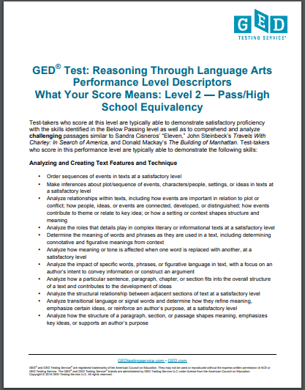
Performance Level Descriptors (PLDs)
Most under-used resources
Helpful tool for the classroom
Details the skills students need to pass the test
Two formats
  Official Version
  Test-taker Version
What skills are demonstrated at each level
What skills need development to advance to the next level
Notes:
Key Points
Performance Level Descriptors (PLDs) explain the skills students must demonstrate to score in each of the possible performance levels on the GED® test and GED Ready®. They are important tools for the classroom. There are two formats that you can access – the official version and the test-taker version (a “friendlier” scripted version of each descriptor).

Slide 30
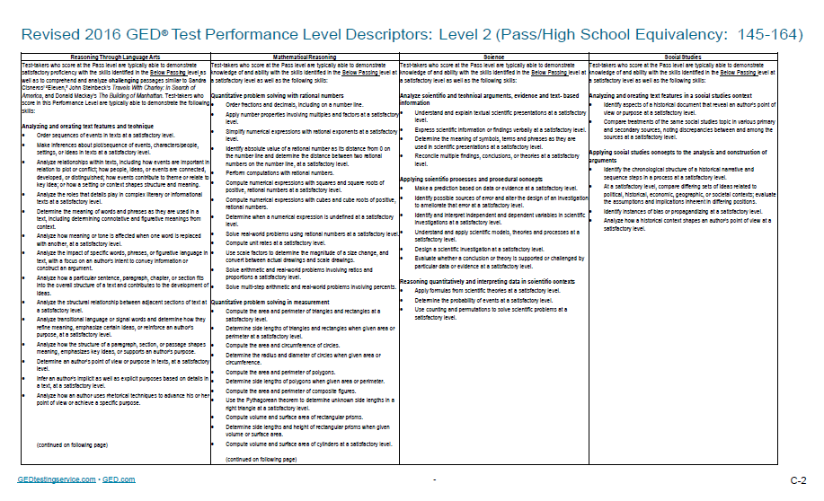
Performance Level Descriptors (PLDs)
PLD’s Across all Content Areas

Slide 31
How to Use PLDs in the Classroom
Use PLDs to:
  Tip 1: Assess student’s current skill level
  Tip 2: Determine when students are ready to test
  Tip 3: Shape learning activities
  Tip 4: Add perspective to lesson plans
Notes:
Key Points
There are many different ways that we can use PLDs to assist us in developing an effective curriculum. Here are four tips to get started.
Tip 1: Use PLDs to assess a student’s current skill level
Identify where to focus in order to develop the skills students need to move to the next performance level
Tip 2: Use PLDs to determine when students are ready to test
Determine if a student should take GED Ready® or the GED® test
Use with the Enhanced Score Report's personalized study plan to create a plan for developing student skills
Tip 3: Use PLDs to shape learning activities
Set learning objectives in your classroom based on the PLDs
Determine if you need to adjust how you're approaching the content
Work one-on-one with students to help develop needed skills
Tip 4: Use PLDs to add perspective to lesson plans
Determine how prepared your students are and create lesson plans accordingly
Identify the gaps in your students’ skills and develop focused lesson plans to address those gaps

Slide 32
Skill Sets for High Impact Indicators Across Content Areas
Focusing Instruction
Notes:
Key Points
The PLDs explain the diverse skills that students must demonstrate to score in each of the possible performance levels on the GED® test and GED Ready®. They are integral to the development of a strong GED® Preparation curriculum. However, often we feel like we have too much to teach and too little time. Plus, we are often faced with multi-level and multi-area classrooms. So, is there a way to better focus instruction? Are there different skill sets that impact instruction across different content areas? Yes, there are. Let’s take a look.

Slide 33

From Performance Level Descriptors to
High Impact Indicators to
Relationships between Indicators
High Impact Indicators
Notes:
Key Points
We all have too much to teach and often too little time, so let’s look at HIIs and relationships.

Slide 34
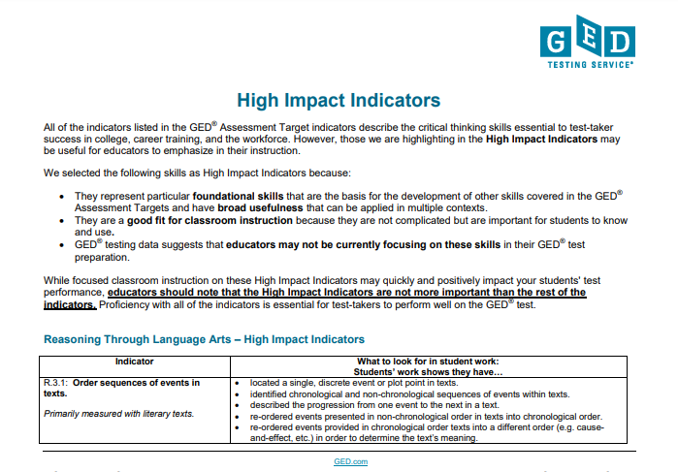
What Are High Impact Indicators?
Important skills that are used across content areas
Based on research
May currently receive light coverage in classroom
Lend themselves to straightforward instruction

Slide 35

It’s All About Relationships
Assist instructors in creating instructional plans that address the maximum number of skills
Assist students in applying skills in multiple ways and in a variety of contexts
Notes:
Key Points
But there is more. Many skills cross content areas. GEDTS® has provided us with another resource to assist us in more completely seeing the relationships across content areas between the high impact indicators.
By better understanding these instructional relationships, we can more effectively create instructional plans that address the maximum number of skills. For many of us who teach all content areas, this is extremely important as often our instructional time is limited. However, it is also important for student learning. By creating lessons that integrate skills across content areas, our students can better apply those skills in multiple ways and in a variety of contexts, and they can see how high impact indicators cross different content areas.

Slide 36
An Example
RLA
Order sequences of events in texts
Social Studies
Identify the chronological structure of a historical narrative and sequence steps in a process
Science
Reason from data or evidence to a conclusion
Mathematics
Search for and recognize entry point for solving a problem and plan a solution pathway
Notes:
Key Points
Let’s look at an example. Think for a moment about this high impact indicator from Reasoning through Language Arts –order sequences of events in texts. Yes, it is important for RLA, especially in literary texts where students need to determine what happened first, second, etc. However, it is also important in Social Studies where students may need to identify a chronological structure of a historical narrative and sequences steps in a process. In science, students need to be able to reason form data or evidence to a conclusion – a sequential approach. Even in math it is important that students are able to sequence text. Think about problem solving and the need for a student to search for and recognize an entry point and then plan an sequenced approach to solving a problem. One indicator with implications for all four content areas.
All of these indicators are related and so are the strategies that we incorporate in to our classroom. By teaching a strategy for ordering texts and ideas more deeply students can then apply this strategy or a similar strategy throughout the different content areas.

Slide 37
Digging Deeper: Let’s Look at Evidence
R.8.3: Evaluate the relevance and sufficiency of evidence offered in support of a claim. Primarily measured with informational texts.
SSP.2.a: Determine the central ideas or information of a primary or secondary source, corroborating or challenging conclusions with evidence.
MP.1 d. Recognize and identify missing information that is required to solve a problem.
MP.5 c. Identify the information required to evaluate a line of reasoning.
SP.4.a Evaluate whether a conclusion or theory is supported or challenged by particular data or evidence
Notes:
Key Points
Let’s dig a little deeper and look at another example of the relationship between indicators and strategies to use in the classroom. Note that on this chart, you see both bolded and unbolded text. The bolded text indicates a high impact indicator. Unbolded text indicates an assessment target or indicator which is not a high impact indicator. However, even if an indicator is not bolded, the indicator does include a related skill. Remember, both are highly important in planning instruction.
Review each box on the chart.

Slide 38
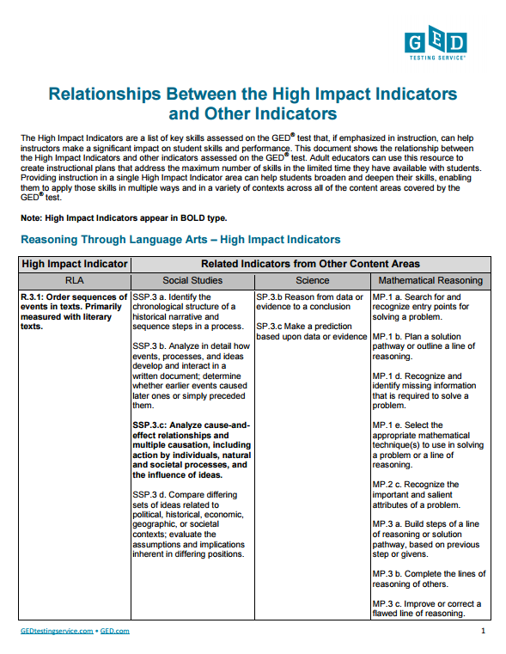
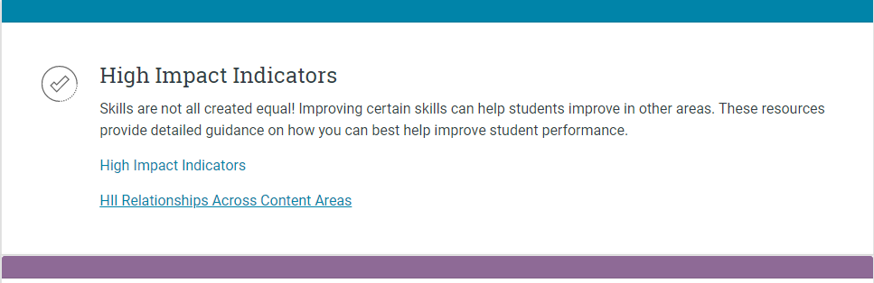
Where to Access HIIs and Relationships
Find them here
High Impact Indicators
Notes:
Key Points
Share with participants how to access the HIIs and the Relationships Chart. Walk through the indicators briefly and show how they

Slide 39
Writing and the GED Test
New Skills for the Test and Beyond
Notes:
Key Points
The next few slides provide a quick overview of the GED® test.

Slide 40
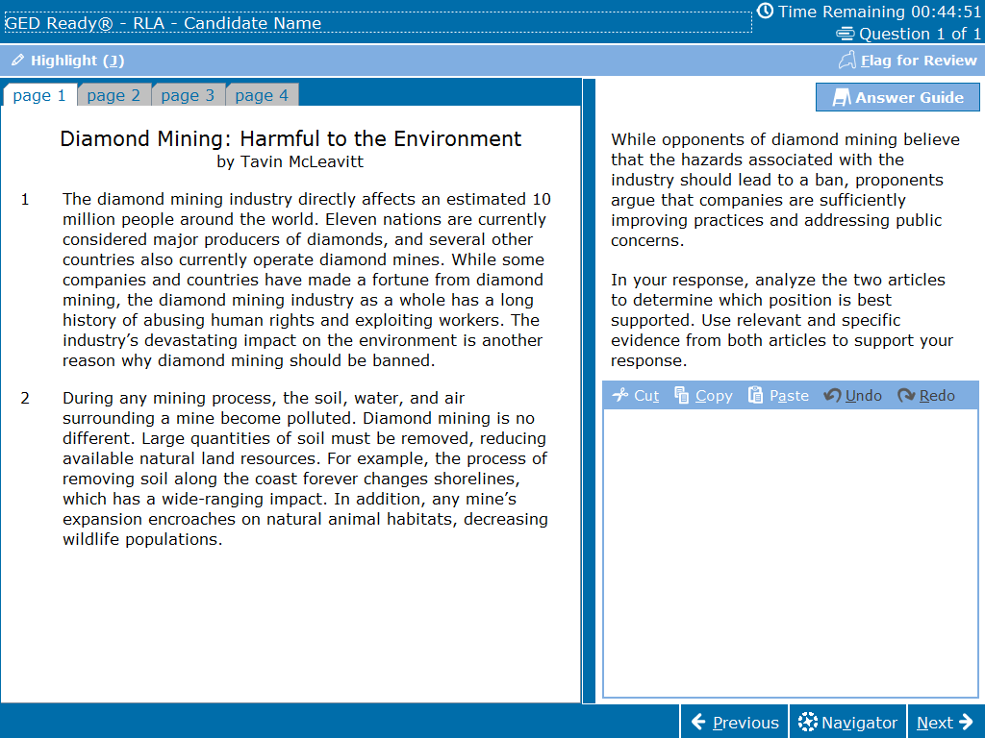
Pilot Study Research Questions
Do test takers
  Understand what they need to do to complete the task?
  Comfortably interact with the computer?
    Use the space in the response box?
    Use the onscreen Answer Guidelines?
    Navigate the tabs successfully?
  Prepare for the test?
    Have a MYGED® account?
    Use the resources on GED.com?

Slide 41
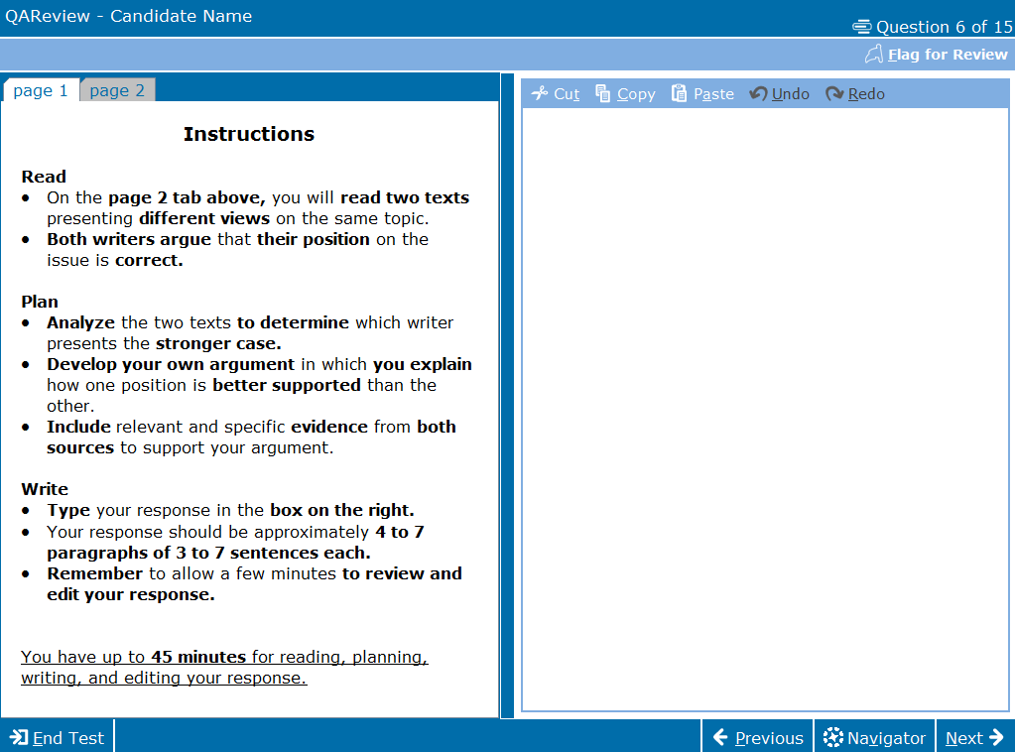
January 2019 release

Slide 42
Purpose of Extended Response
To provide test-takers with an opportunity to demonstrate
Knowledge of writing conventions in English
Understanding of what they’ve read
How well they use evidence to build arguments
Their ability to clearly communicate their thinking in their own words

Slide 43
Constructed Response on RLA
A constructed response item includes:
One or more source texts
Texts offer two positions on a given topic
A prompt that provides instruction on what the students is expected to do

Slide 44
The Three Trait Rubric
Trait 1: Creation of Arguments and the Use of Evidence
Trait 2: Development of Ideas and Organizational Structure
Trait 3: Clarity and Command of Standard English Conventions

Slide 45
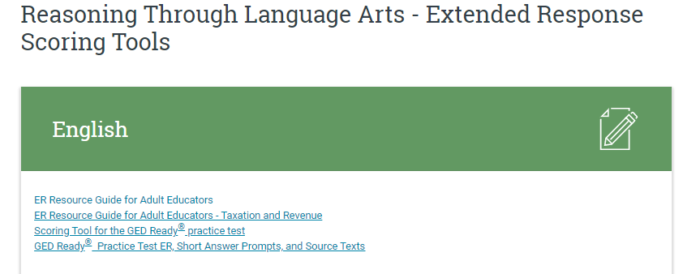
Where can you find the Rubric?
Assessment Guide for Educators on pages 22 and 23
Extended Response Resources

Slide 46
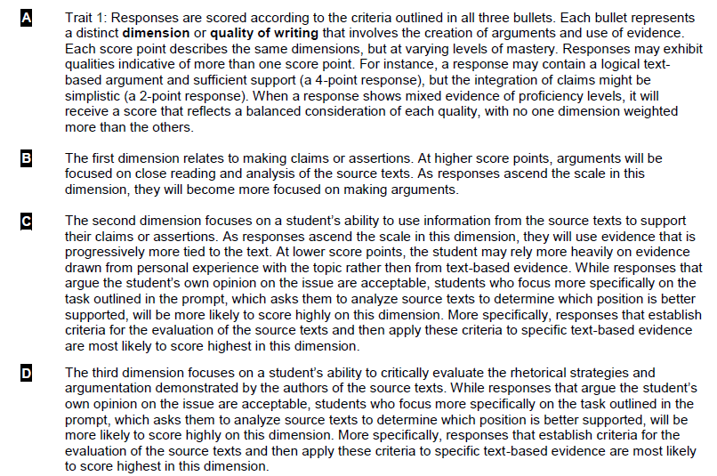
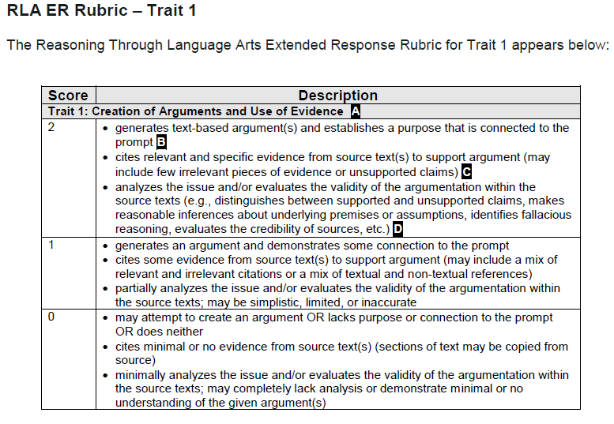
Annotated Rubric

Slide 47
Know What is Expected
When you write . . .
determine which position presented in the passages is better supported by evidence from the passages
explain why the position you chose is the better-supported one
remember, the better-supported position is not necessarily the position you agree with
defend your assertions with multiple pieces of evidence from the passages
build your main points thoroughly
Notes:
Key Points
Test-takers should be familiar with the expectations of the constructed response prior to taking the test. This information should be an integral part of classroom instruction.
[Review the bullets on the slides.]

Slide 48
Don’t Forget the Little Stuff
Expose students to a structured approach to the writing task and help them understand that they need to:
Write a complete response (approx.300-500 words), not just a short paragraph
Provide commentary on the evidence cited (explain the “why”)
Fully develop two or three ideas, rather than mention a lot of things without detail
Leave five minutes at the end for proofreading—that is one of the things evaluated
Notes:
Key Points
[Review the bullets on the slides.]
Discuss that these are ideas on how to improve scores. Also, note that the length is not about counting words, but rather is indicates that the writing sample needs to be long enough to adequately address the prompt. A short paragraph is not enough.

Slide 49
Inquiring Minds Want to Know
Reasoning through Language Arts

Slide 50

Burning Question - Extended Response Items and Scoring
Can you pass the RLA test and score 0 on the ER item?
  Yes, but most test-takers who pass at HSE do get some score points
  How much to write?
    4-7 paragraphs with 3-7 sentences
    No word counter on screen
Don’t score for spelling
Due to time constraint 45mins the expectation is draft writing

Slide 51

Burning Question - Extended Response Items and Scoring
Why should I spend time on teaching writing skills if students don’t need many points on writing to pass the test?
  Writing skills are one of the critical differentiators of long-term success
  Any score point earned counts towards the overall score
  Building skills in this area helps develop thinking skills that impact performance on the entire test

Slide 52

Burning Question - Extended Response Items and Scoring
How does the computer score the ER item? What is it looking for?
  The automated scoring engine catalogs the characteristics of a writing sample
  Compares those characteristics to real exemplar responses with known score
  Assigns a score based on similarity to existing exemplars
    If no similar responses found, ER is human-scored

Slide 53

Incorporate reading and writing into every classroom, every day
Notes:
Key Points
The next tip is to incorporate reading and writing into every classroom, every day.

Slide 54
The Link Between Reading and Writing
Students who read,
write better.
Students who write,
read more.
Reading strategies should lead to writing
Writing strategies should encourage further reading
Notes:
Key Points
There is a link between reading and writing. We have known that for a long time. Students who read – write better. Students who write – read more. So as we look at strategies for the classroom, we need to ensure that the reading strategies that we select lead to writing and that the writing strategies we select encourage further reading.

Slide 55

Where to Access More Strategies on Close Reading
Tuesdays for Teachers
Webinars
Close Reading: A Key to Teaching Constructed Response
(May 26, 2015)
  Close reading strategies webinar
Mathematical Reasoning
(March 24-26, 2015)
  Close reading in mathematics
Notes:
Key Points
Two webinars focused specifically on strategies for close reading.
Discuss the two webinars and that participants should download the resources to learn more.

Slide 56

Where to Access a Step-by-Step Guide for Argumentative Writing
Tuesdays for Teachers
Thinking Strategies for Crafting Constructed Responses (Part 1) (May 24, 2016)
  Link
Thinking Strategies for Crafting Constructed Responses: One Step at a Time (Part 2)
(June 2016)
  Link
Notes:
Key Points
Would you like a step-by-step guide for helping your students integrate reading and writing through the crafting of an argumentative writing sample? Access the two webinars from Tuesdays for Teachers. These two webinars provide you with hands-on activities that you can use in your classroom. Make sure to model each routine first.

Slide 57
Test Taking Tips for RLA ER
Always complete the constructed response! (You cannot use the 45 minutes provided for any other part of the test.)
Closely read the prompt and source texts, analyzing and evaluating the evidence before determining your claim.
Practice using the highlighting tool and the erasable note boards for planning.
Plan your time
  Use the entire 45 minutes to read, plan and write your response
  Spend 10-15 minutes in reading and planning
  Save 4-5 minutes to proofread your response

Slide 58
Building Student Knowledge and Critical Thinking Skills
Social Studies
Notes:
Key Points
Share with participants that in order to be successful on the test, students need to be able to closely read complex text. Building student knowledge can be done in conjunction with the teaching of critical reading skills.

Slide 59
Social Studies Themes
 |  | Social Studies Example Topics
 |  | Civics & Gov’t (50%) | US History (20%) | Economics (20%) | Geography & World (15%)
Focusing Themes | Development of Modern Liberties and Democracy | Types of modern and historical governments Structure and design of U.S. government | Key historical documents Civil War and Reconstruction | Key economic events that shape American government and policies | Development of classical civilizations
 | Dynamic Responses in Societal Systems | Political parties, campaigns, and elections Contemporary public policy | World War I & II Cold War | Fundamental economic concepts Economic causes and impacts of war | Borders between peoples and nations Human migration
Notes:
Key Points
As you look at the PLDs, you’ll notice that there still is a lot of content to teach. However, the GED Testing Service® has taken those four areas and incorporated the content under two Focusing Themes. That helps tremendously in narrowing the focus of instruction in social studies.
Development of Modern Liberty and Democracy is the first focusing theme. This theme explores how democracy and human and civil rights have changed overtime. Think – major events such as the founding of the U.S., the civil rights movement, as well as some of the big thinkers of American government such as Thomas Jefferson and James Madison.
Dynamic Responses in Societal Systems looks at how systems, structures, and policies have evolved over time because of different conditions and events that have occurred. Think – major events that have shaped policy such as the Great Depression or the Cold War or even how people have settled near oceans and rivers in order to ship goods.
For more information on Focusing Themes, access the chart in your workbook.

Slide 60
What Should I Teach?
Social Studies Content
(GEDTS Assessment Guide – Social Studies)
Social Studies Focusing Themes
Social Studies Practices
Students apply skills of analyzing and evaluating to create meaning and understanding
Notes:
Key Points
SS practices of applying skills of analyzing and evaluating.
So, what should you teach in the social studies classroom?

Slide 61
Test-taking Tips for Social Studies
Remind students to read closely and carefully, especially primary sources
Examine graphics closely
Use calculator for data and statistics items

Slide 62
Building Student Knowledge and Critical Thinking Skills
Science
Notes:
Key Points
Share with participants that in order to be successful on the test, students need to be able to closely read complex text. Building student knowledge can be done in conjunction with the teaching of critical reading skills.

Slide 63

"If it's green or wriggles, it's biology.
If it stinks, it's chemistry.
If it doesn't work, it's physics..."
Handy Guide to Science
Notes:
Key Points
Read the quote.

Slide 64
Focusing Themes of Science
 |  | Science Content Topics
 |  | Life Science (40%) | Physical Science (40%) | Earth & Space Science (20%)
Focusing Themes | Human Health and Living Systems | Human body and health Organization of life Molecular basis for heredity Evolution | Chemical properties and reactions related to human systems | Interactions between Earth’s systems and living things
 | Energy and Related Systems | Relationships between life functions and energy intake Energy flows in ecologic networks (ecosystems) | Conservation, transformation, and flow of energy Work, motion, and forces | Earth and its system components Structure and organization of the cosmos
Notes:
Key Points
It is often difficult to determine what to teach in the science classroom. The GED® Science test has identified focusing themes for this test. These two themes have application across all domains of science. As such, they are a way of linking the different content areas of science that are assessed by the GED® test. The two focusing themes are human health and living systems and energy and related systems. Each science content topic is assessed using one of these focusing themes.
Review the chart.
Note: A copy of the chart is in the workbook.

Slide 65
What Should I Teach?
Science Content
(GEDTS Assessment Guide – Science)
Science Focusing Themes
Science Practices
Students apply skills of science to develop an understanding of the scientific concepts.
Notes:
Key Points
Science practices are students applying skills of science to develop scientific concepts.
So, what should you teach in the classroom?

Slide 66
Instructor Focus -- Can your students . . .?
  Evaluate whether data supports a hypothesis?
Identify variables in an experimental process?
Determine a method for collecting data?
Determine the correct process for an experiment?
Draw a conclusion based on scientific data?
  Design a scientific investigation based on a given hypothesis?
Create a hypothesis?
Notes:
Key Points
Begin the discussion on the scientific method by asking participants if their students can do the items listed. Reinforce that these skills are necessary for both technology-enhanced items.

Slide 67
Focus on Concepts and Problem Solving
Mathematical Reasoning
Notes:
Key Points
Explain that students need to build their conceptual understanding of mathematics as well as how to apply those concepts in word problems. Students often lack consistency in solving problems because they do not truly grasp the concepts and/or skills they need to use.

Slide 68
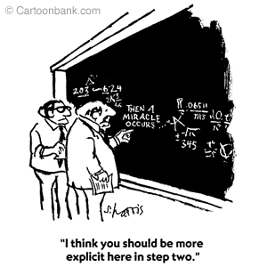
Problem-Solving in the Classroom
Notes:
Key Points
Give participants a moment to consider this question individually and then discuss it with a partner. Depending on the time you have available, you may or may not elect to have a brief whole group discussion.

Slide 69
Teach the Big Ideas in Algebra
Variable
Symbolic Notation
Equality
Ratio and Proportion
Pattern Generalization
Equations and Inequalities
Multiple Representations of Functions
Notes:
Key Points
Ask participants what they are currently teaching from this list. Chances are very good that they will indicate ratio and proportion and possibly variables or symbolic notation. However, rarely will participants indicate that they are currently teaching all of these “big” ideas.
Explain that over the next few slides, they will have an opportunity to look at some of these “big” ideas and identify ideas that students need to learn if they are going to build algebraic reasoning skills.

Slide 70
Focus on Problem Solving
Polya’s Four Steps to Problem Solving
Understand the problem
Devise a plan
Carry out the plan
Look back (reflect)
Polya, George. How To Solve It, 2nd ed. (1957). Princeton University Press.
Notes:
Key Points
George Polya’s Four Steps to Problem Solving has stood the test of time and today is still one of the most widely used process for teaching students the process for solving problems.
These steps provide test-takers a framework for building solution pathways when working with mathematical content. Students in adult education classrooms often want to just “do” the problem. This is analogous to the approach students often taken to writing – they just “write.” They do not want to read, plan, organize, edit and revise – they just want to write and move to the next task.
Students need to understand that solving problems requires planning, drafting (trying the plan), checking results, and making “edits and revisions” if the answer is not correct or reasonable.
Polya outlines four basic steps.
Understand the Problem: Determine what is being asked, what information is known, what information is unnecessary to addressing the problem, and what information is missing or not known.
Devise a Plan: Find a strategy to help in solving the problem.
Carry Out the Plan: Attempt to solve the problem with the chosen strategy. If the strategy does not work, try another strategy.
Look Back: Check to see if the answer “makes sense.” A good way to look back is to use another strategy to see if the same answer results.

Slide 71
Help Students . . .
Build their reading skills
Use close reading skills to determine what the word problems is asking
Build math vocabulary
Tackle problems in three waves
  Do problems that are easily and quickly completed
  Go back to problems that will take a little longer
  Save the most challenging problems for last
Notes:
71
Think about the skills that effective readers have.
[Review the bullets on the slides.]
Now, think how this ability would impact their ability to read and solve math problems. Each of the items listed is essential in students being able to understand what the math problem is telling them, as well as what they need to do to solve that problem.

Slide 72
GED Ready®
Assessing Readiness
Notes:
Key Points
Many participants want to know how they can ensure that their students are ready to take the official test. The GED Ready® practice test is the best predictor or readiness.

Slide 73
GED® Ready
Realistic practice opportunity | Computer based and same platform as GED® test
Standardized and normed | Same norming and standardization study as official test
Predictive | Tells students if they are likely to pass
Half-length | 4.25 hours in length
Notes:
Key Points
The GED Ready® practice test has the same look and feel as the official GED® test, and gives students firsthand experience answering computer-based test questions written and developed by the test’s creators. The score report tells students if they are likely to pass or if it’s too close to call and they should keep studying. The test is half-length and takes approximately 4.25 hours. And just like the official test, GED Ready ® can be taken separately by content areas (RLA, Mathematical Reasoning, Social Studies, and Science).

Slide 74
Three Score Levels on GED Ready®
Not Likely to Pass | Too Close to Call | Likely to Pass
100-133 | 134-144 | 145-200
Notes:
Key Points
Three Score Level Indicators on GED Ready®
Individuals taking GED Ready® receive a detailed score report with a scaled score indicating their likelihood of passing the operational GED® test. Test-takers will receive a score within one of three levels: Red Zone (not likely to pass), Yellow Zone (too close to call), or Green Zone (likely to pass). Note the scores for each of the levels.

Slide 75
GED® Ready
Score Report
Feedback and links to study suggestions (focused study plan)
Instructional feedback – extended response (RLA) scored by adult educators
Online scoring tools (provide writing scores, feedback, and suggestions for improvement)
Notes:
Key Points
The GED Ready® practice test is synced to publisher books and courses and gives every student their own targeted study plan based on the skills he or she needs to work on, including specific guidance on what to study in publishers’ test prep materials.
The extended response and short answers are not score by the automatic scoring engine. Instead, the adult educator (classroom instructor) scores both the extended response and the short answer items. The reason for this is so that instructional feedback can be provided to the student (test-taker). To assist the individual scoring the writing samples, online scoring tools have been developed by GEDTS® to provide a rubric for scoring, feedback, and suggestions for improvement. The adult educator has access to the stimulus materials and the prompts via the website. A copy of the test-taker’s writing samples can be accessed and downloaded through the test-taker’s MyGED® portal.
Note: If science short answers return in future versions of the GED Science test, educators will need to score the students’ responses for those items.

Slide 76
Resources
Tools for Test-Takers and Resources for Educators
Notes:
Key Points
There are many more resources from GEDTS. Let’s spend a few minutes to look at some of the resources available – both for test-takers and for educators.

Slide 77

Home for All Things GED®
International Educators and Admins
Notes:
Key Points
All of these resources and more live on the GED Testing Service® website – your primary resource as a GED® trainer.

Slide 78
3 Things Every Educator Should Do
Create an account at GED.com & familiarize yourself with the student experience in order to help your students (use a non-work email address).
Take at least one subject of the GED Ready. Ask Ben, your International Director for a GED Ready voucher.
Bookmark and utilize GED.com – Educators & Admin
Notes:
78
Think about the skills that effective readers have.
[Review the bullets on the slides.]
Now, think how this ability would impact their ability to read and solve math problems. Each of the items listed is essential in students being able to understand what the math problem is telling them, as well as what they need to do to solve that problem.

Slide 79

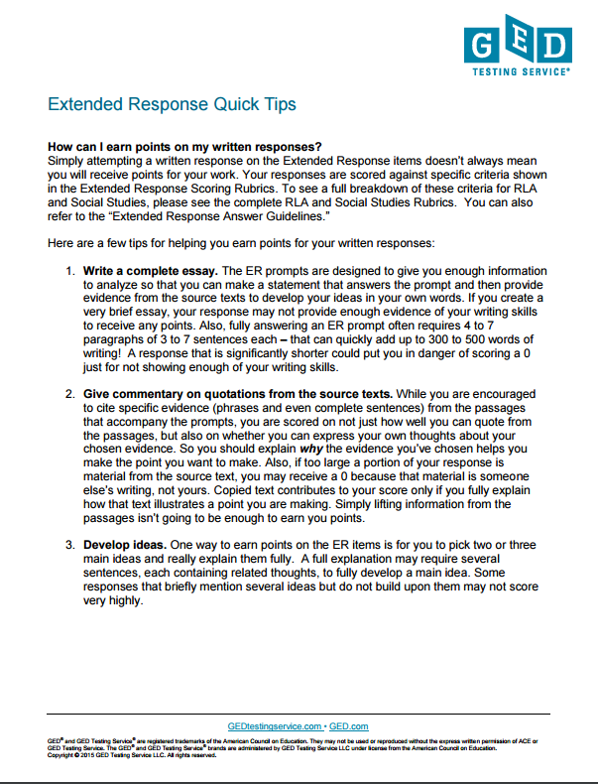
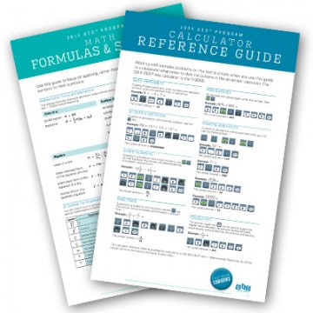

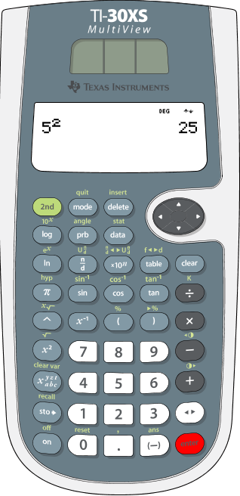
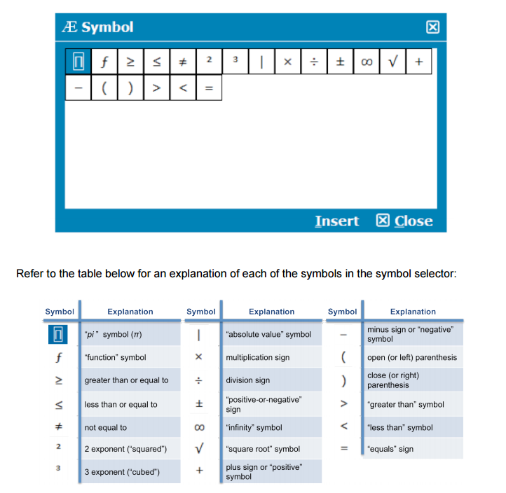
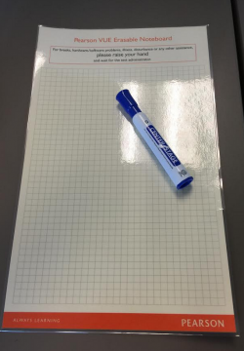
Tools – Tools – Tools!
Videos and Tutorials
Quick Tips
Calculator Tutorial
Calculator and Formula Reference
Æ Symbol Tool Explanation
Erasable Note Boards
Additional Tools
  Flagging Items for Review
  Item Review Screen
  Test Timer
  Test Progress Indicator
Notes:
Key Points
For best success, test-takers need to be familiar with the various tools available to them. Reinforce with instructors how these tools should be an integral part of instruction. Their students should have opportunities to use them prior to the test so that they better understand the functionality of the tools, as well as what is expected of them to know via content knowledge, problem solving, and critical thinking. Become familiar with each of the test-taking tools on this slide and the next.

Slide 80
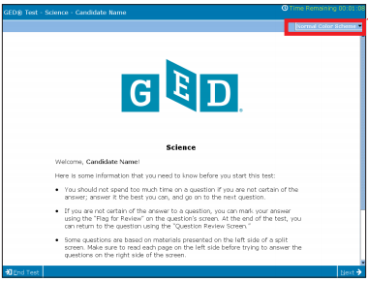


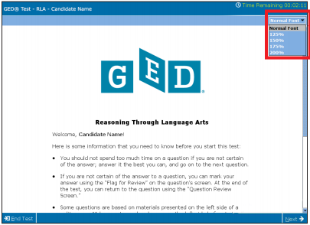
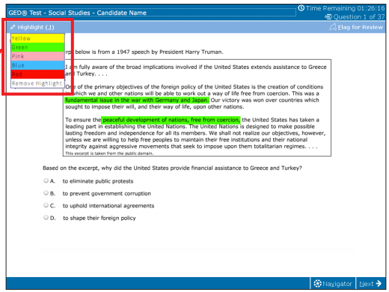
Tools – Tools – Tools!
On-screen Color Combinations
On-screen Text Size changes
On-screen Highlighter
Notes:
Key Points
But there are more. Many test-takers are unaware that they have other tools at their disposal. These tools should be integrated into classroom instruction as test-taking tips so that students can easily use them in the testing situation. Note that these tools are available to all test-takers. An accommodation request is not needed. The following are important tools with which all educators should be familiar.
On-screen color combinations – Test-takers can choose from 11 different background/text color combinations to make the test screen easier to read
Text size – Test-takers can use the “Custom Font” button to change the text size on the test
Highlighting text – Test-takers can select text and click the “Highlight” button to highlight test questions and passages.
Keyboarding shortcuts – Cut/paste/move/remove, etc.
It is important that students practice on the computer-based tutorial prior to the test. All features are shown in the tutorial.
Computer Tutorial is located at: https://ged.com/educators_admins/teaching/classroom_materials/

Slide 81




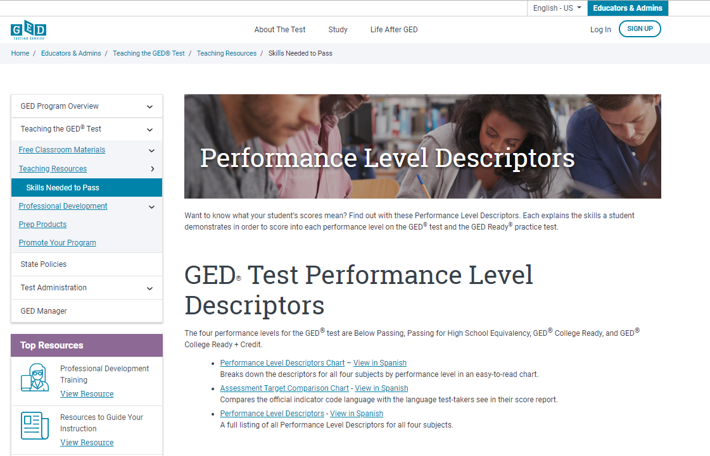
Need more information?
9 Helpful Resources
Notes:
Key Points
The following are resources that you will want to explore as an integral part of being trainer. Many of the resources you have probably already explored. However, there are always new resources available from GEDTS so you will need to continue to stay current.
Adult educators can access the Educators portion of GED.com at: https://ged.com/educators_admins/program/

Slide 82

#1 The Assessment Guide for Educators
Covers all content areas
Item types
Assessment targets
Guidelines for how items are scored
More . . .
Notes:
Key Points
Review information on the slide regarding the resource (where it is located and what is included).
Complete Assessment Guide for Educators is located at: https://ged.com/wp-content/uploads/assessment_guide_for_educators_all_subjects.pdf

Slide 83


#2 Teaching Resources
Notes:
Key Points
Review information on the slide regarding the resource (where it is located and what is included).
Teaching Resources are located at: https://ged.com/educators_admins/teaching/teaching_resources/

Slide 84

#3 “Tuesdays for Teachers”
Recorded presentation
Slideshow document
Resources – including strategies & classroom activities
More . . .
Webinars
Notes:
Key Points
Review information on the slide regarding the resource (where it is located and what is included). Make sure to discuss that archived webinars provide:
A recorded presentation of the live webinar
A copy of the slides provided to participants
Resources – a guide that you can download and print that includes instructional strategies and classroom activities. Some of the guides also provide you with sample lesson plans and a list of great websites to visit for more ideas and information.
Dependent on the webinar, additional materials may also be linked to the webinar.
Tuesdays for Teachers Archived Webinars are located at: https://ged.com/wp-content/uploads/relationships_between_HII_and_other_indicators.pdf

Slide 85

#4 In Session
Monthly newsletter
Easy sign-up
Topics of interest to adult educators
Focus on changes that impact you and your students
Promotions US based
https://ged.com/in-session/
Notes:
Key Points
Review information on the slide regarding the resource (where it is located and what is included). Reinforce that everyone should be signed up for this newsletter.
Adult educators may register for In Session at: https://ged.com/educators_admins/program/
Note: Scroll to bottom of page to see registration box.

Slide 86
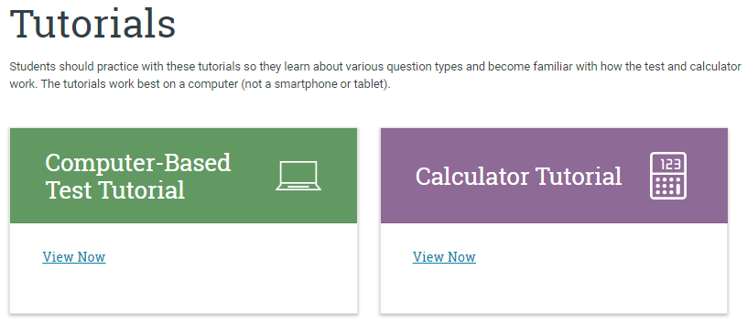
#5 Tutorials
Tutorials
Ensures no surprises on test day
Opportunity to practice and build skills
Familiarity can lead to better performance
Notes:
Key Points
Review information on the slide regarding the resource (where it is located and what is included). Reinforce that the tutorials can be accessed online or can be downloaded. Students should be familiar with all of tutorials and should have practiced using them prior to testing.
Computer and calculator tutorials are located at: https://ged.com/educators_admins/teaching/classroom_materials/

Slide 87
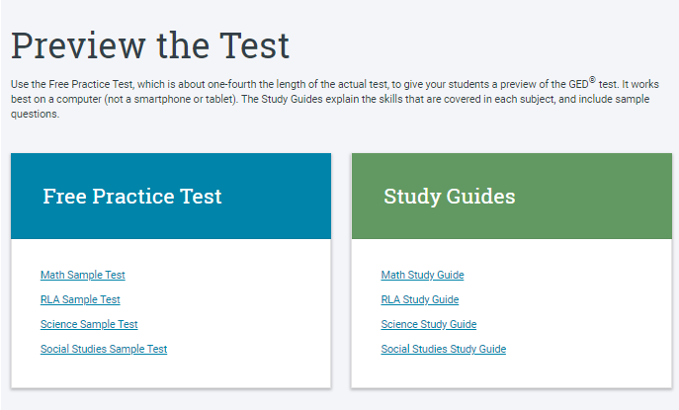
#6 Free Practice Tests
All 4 content areas
10 questions on each test
Answer Explanations
Free Practice Tests
Notes:
Key Points
Review information on the slide regarding the resource (where it is located and what is included). Reinforce that the tutorials can be accessed online or can be downloaded. Students should be familiar with all of tutorials and should have practiced using them prior to testing.
Computer and calculator tutorials are located at: https://ged.com/educators_admins/teaching/classroom_materials/

Slide 88
#7 Study Guides
Study Guides
All 4 content areas
Describes what you need to know about the test
Describes the skills with example questions
Notes:
Key Points
Review information on the slide regarding the resource (where it is located and what is included). Reinforce that the tutorials can be accessed online or can be downloaded. Students should be familiar with all of tutorials and should have practiced using them prior to testing.
Computer and calculator tutorials are located at: https://ged.com/educators_admins/teaching/classroom_materials/

Slide 89
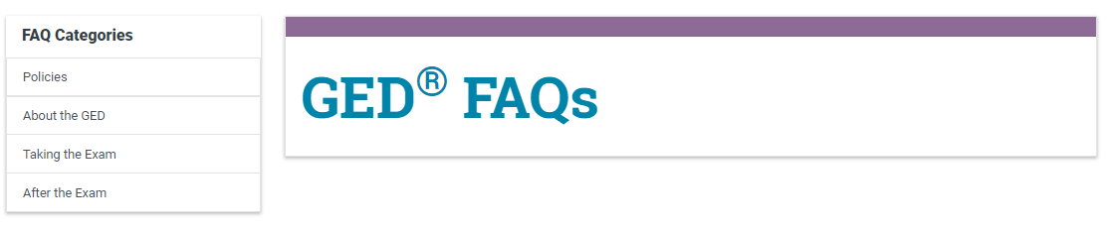
#8 FAQs
International FAQs
Notes:
Key Points
Discuss that FAQs are constantly being updated and added to as new questions are asked. Note that there are FAQs for both Educators and Test-Takers.
FAQs are located at: https://ged.com/faq

Slide 90
#9 GED Resource Links
Educators &Admins page
https://ged.com/en/international_prep_providers/
Classroom materials
Free Classroom Materials
Here you find the Tutorials, the Free Practice Tests and all of the reference guides to prepare your students. The Scoring tool is also here.
Teaching Resources
Student Skills
This page is very useful for teachers to become familiar with the skills assessed on the test, Performance Level Descriptors and the High Impact Indicators.
Professional Development
Webinars
Here are the webinars that teachers can watch to become familiar with many different topics.

Slide 91


Slide 92
Break

