Slide 1
Bridging GED® Grads to College
Victor Fitzjarrald, GED Testing Service
August 2025
GED® and GED Testing Service® are registered trademarks of the American Council on Education (“ACE”). They may not be used or reproduced without the express written permission of ACE or GED Testing Service LLC. The GED® and GED Testing Service® brands are administered by GED Testing Service LLC under license from ACE.
Notes:
Survey of states represented
My area is post credential education and pathways
This is what I would tell every credentialer about starting college, given the chance.
By the end, everyone will have 1 or more tools to help a learner transition from GED to College

Slide 2
Outline
GED® Candidates and Graduates
Where are they going?
What are bridge programs/courses?
How do we help GED® Grads?

Slide 3
The GED Learners
Data about GED Candidates and Graduates

Slide 4

GED.com Average Candidate (last 12mo)
Predominantly non-White (61%) Male (51%)
Non-Hispanic (30%) – predominately English speaking.
15*-24yrs old (45.84% of learners)
Completed ~11th grade
Mostly uses Adult Education (40%) with GED Ready® (17%).
Studies with a physical book (14%).
Goes to GED.com in hopes of going to college (37%).
*: While we have a lot of users registering in the 15-18 range, it is rare for them to be able to test
Notes:
Demographic Extracts:
15% ages 16-17, 25% ages 18-19, 22% ages 20-24, 22% ages 25-34, 17% ages 35+
8% middle school or less, 13% 9th grade, 22% 10th Grade, 23% 11th Grade, 25% 12th Grade
40% use adult ed classes, 17% use GEDReady, 14% use Books, 10% online courses.

Slide 5

GED.com Average International Candidate
Female (50%) non-white (99%)
Non-Hispanic – predominately English speaking (international tests are only in English)
17 years old (16-19yo students = 84%)
Completed ~10th grade (higher probability as you progress)
Mostly uses Adult Education with higher percentage use of GED Ready® and Study Books.
The GED® program is an entrance point to US education, better employment, and potential migration.
Notes:
Demographic Extracts:
44% Male, 50% Female
46% ages 16-17, 38% ages 18-19, 13% ages 20-24, 2% ages 25-34
8% middle school or less, 14% 9th grade, 29% 10th Grade, 20% 11th Grade, 18% 12th Grade
40% use adult ed classes, 23% use GEDReady, 22% use Books, 10% online courses.

Slide 6

GED&Me Average Candidate
Female (56%) Hispanic (35%) White (39%)
Predominantly English speaking but would like Spanish content.
22yrs old (20-24yo students = 30% with 24-30yo being 28%)
Core focus: taking better care of my family. Accesses GED & ME™ as a tool to do that.
Notes:
Demographic Extracts:
44% Male, 50% Female
46% ages 16-17, 38% ages 18-19, 13% ages 20-24, 2% ages 25-34
8% middle school or less, 14% 9th grade, 29% 10th Grade, 20% 11th Grade, 18% 12th Grade
40% use adult ed classes, 23% use GEDReady, 22% use Books, 10% online courses.

Slide 7
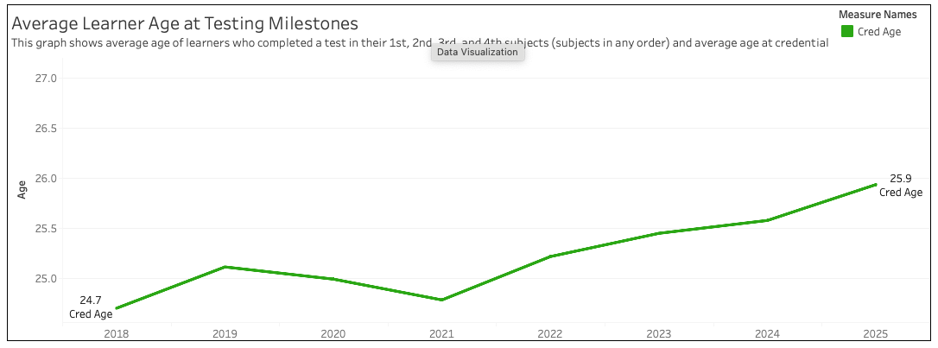
Average Graduate Age:
25.9 (and trending up)

Slide 8
Why do students get a GED® Credential?
Let's talk about some data – it is my love language!

Slide 9
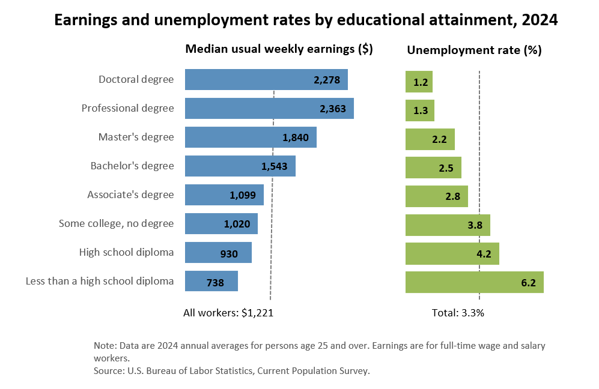
Takeaway: The GED® Credential is a steppingstone to increased salary and lower unemployment.

Slide 10
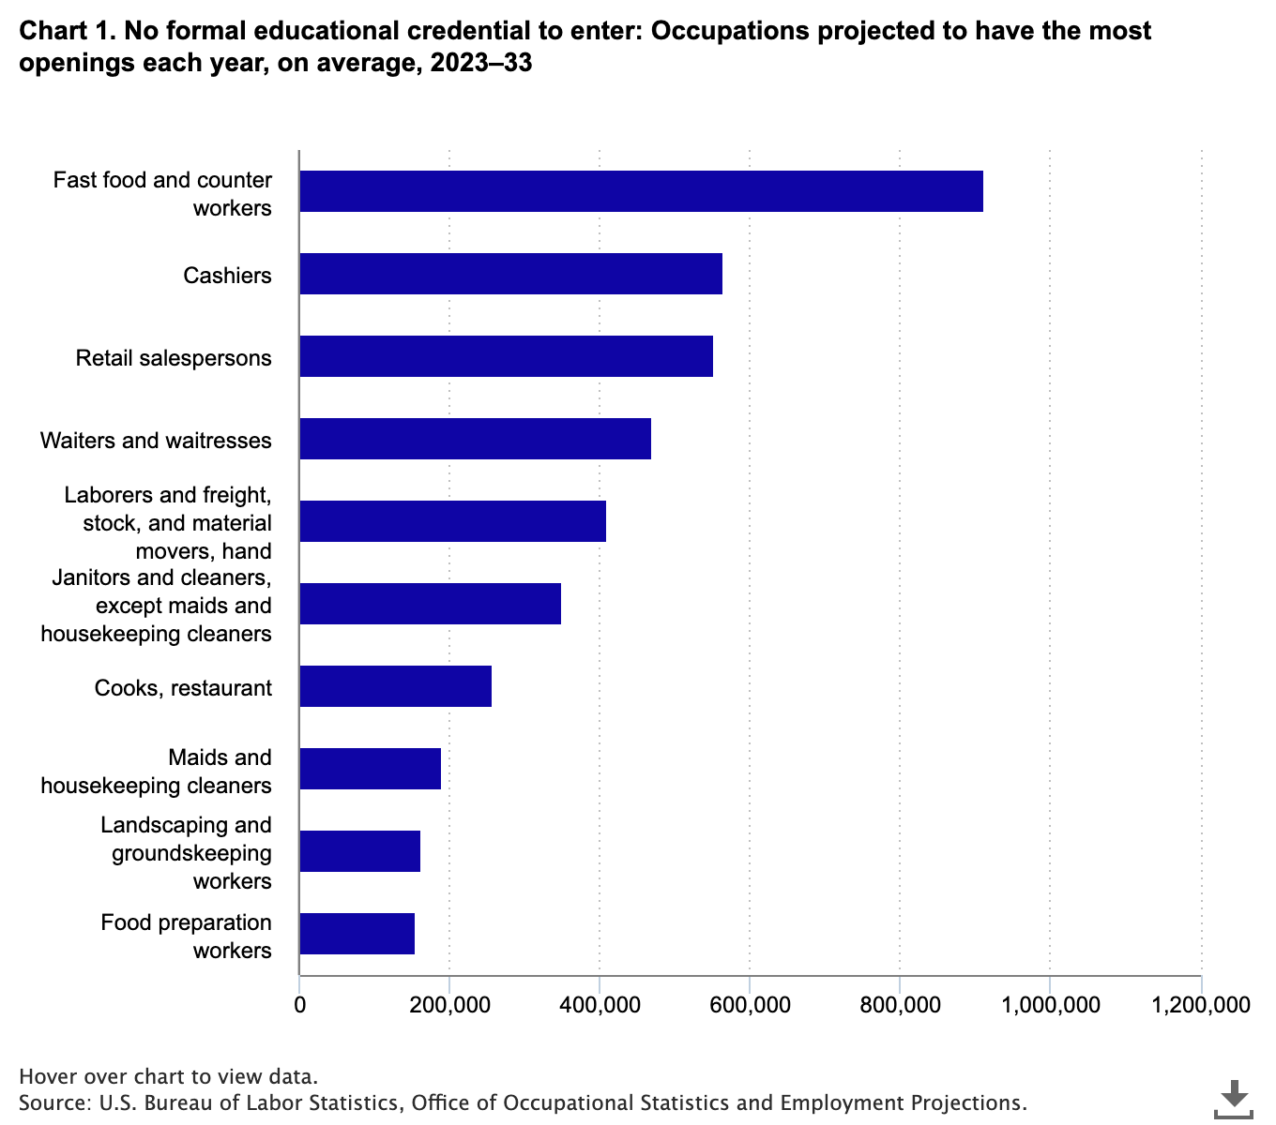
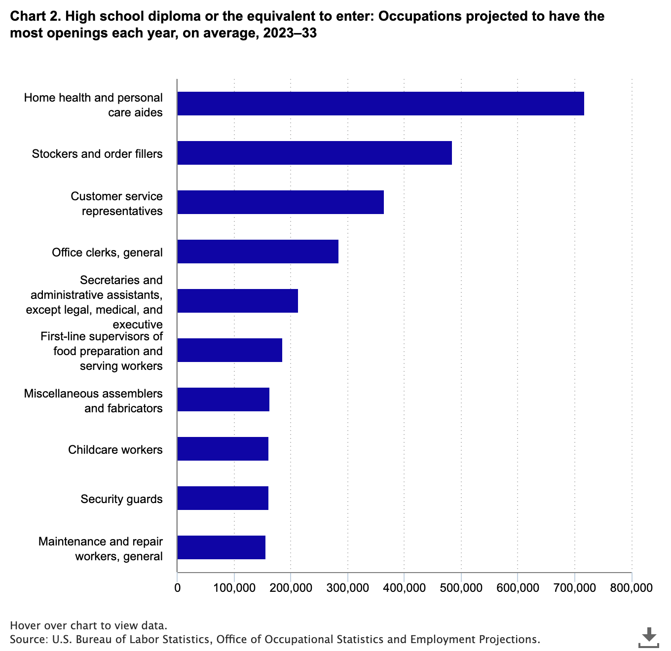
Before…
After…
What if…

Slide 11
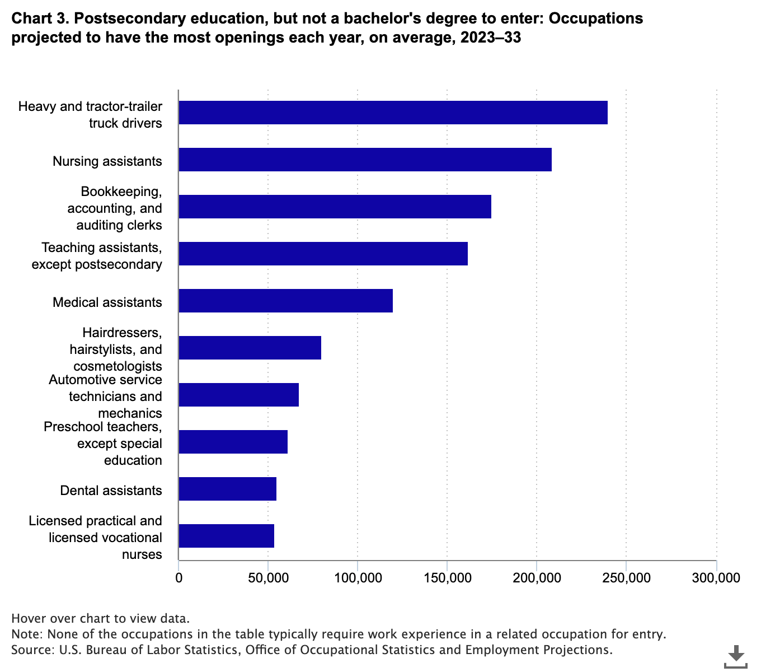
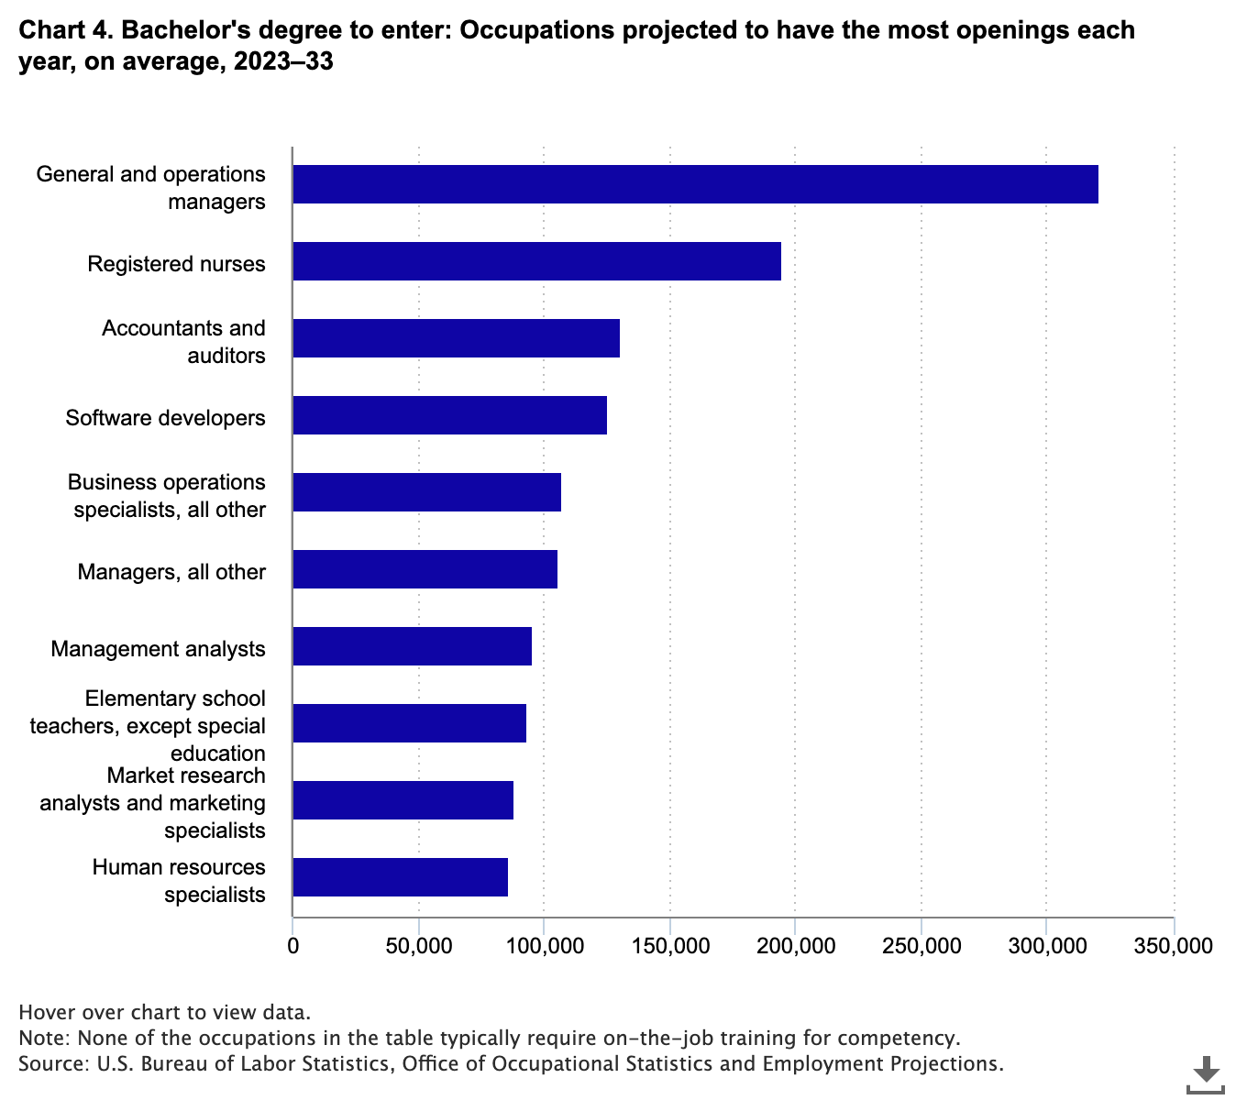
Certificates
Bachelors

Slide 12
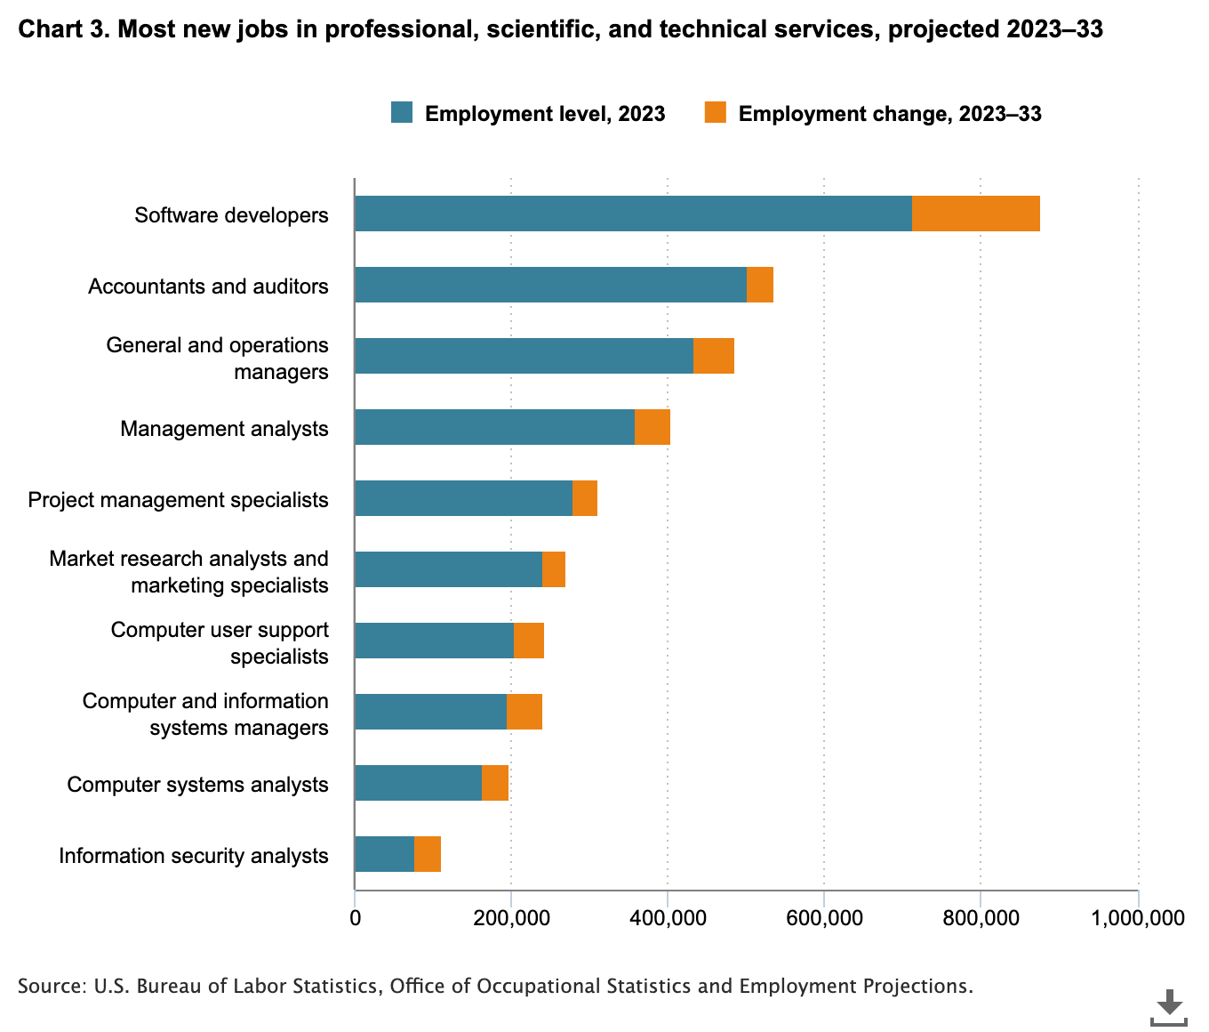
In the most growing job market, which of the top growing skills are accessible with just a high school diploma? With certificates? With Bachelors?
Are these some of the jobs that your graduates are looking at?

Slide 13
I am 26, I have a GED, now what?
How do I get my dream job?

Slide 14



What do our Graduates face?
Unemployment
Credentials
Returning
Unemployment rate for people with only a high school
diploma was more than twice as high as for those with a bachelor’s
degree or higher.
Despite ongoing concerns …, nearly all adults without a college degree say at least one type of credential is “extremely” (74%) or “very” valuable (20%).
59% of unenrolled adults have considered enrolling in additional education in the past two years, an increase of 15 percentage points from the 44% who said the same in 2021.
Source: National Center for Education Statistics 2022, Lumina Foundation 2024
Notes:
https://www.ged.com/wp-content/uploads/press_release_college_enrollment.pdf

Slide 15
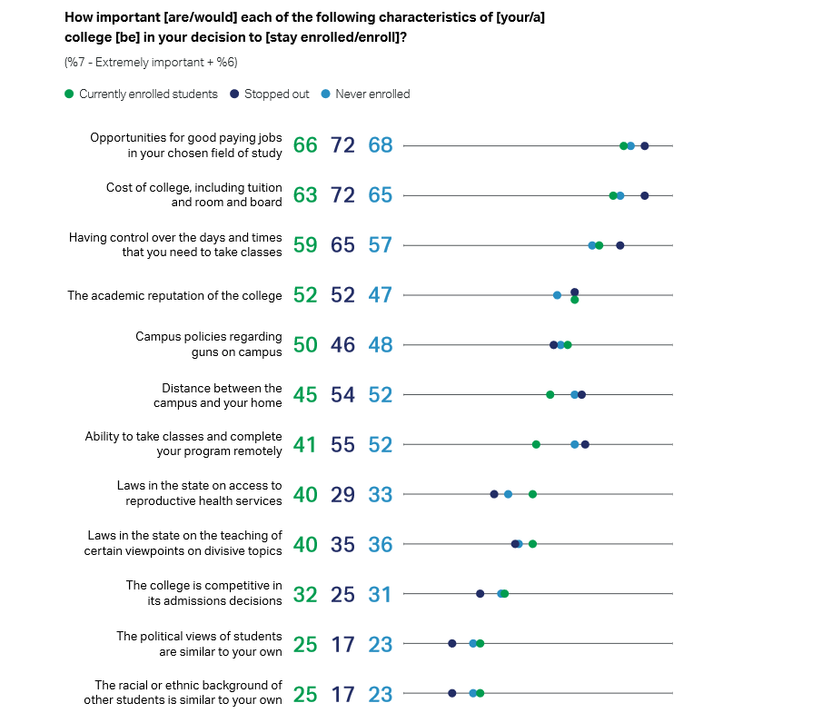
Employment Motivation
Source: Lumina Foundation 2024
Notes:
Career outcomes — such as earning a raise, promotion or a more fulfilling role — are the primary motivators for pursuing higher education. Eighty-four percent of current or prospective students cite at least one employment-related factor as why they are enrolled or considering pursuing a degree or credential. – Lumina 2024 https://www.luminafoundation.org/wp-content/uploads/2024/05/State-of-Higher-Education-2024.pdf

Slide 16
86% of GED® grads need enhanced support to succeed in transfer level college work.
Source: GED Outcomes Study

Slide 17




It is not an easy journey!
Graduate Highschool
Enrollment
Discouragement
No Progress
Learner completes high-school/GED and begins to dream of college.
Learner begins the arduous process by choosing a college and degree, funding, and applying
Learner is not well prepared and/or encounters hardship
35% graduation rate for learners attending 2 year schools*
Source: National Center for Education Statistics

Slide 18
"Only 23% of two-year attendees and 37% of four-year college students who start in remediation complete the gateway course."
Source: Forbes 2018 (most recent study)

Slide 19
Math and English Support Models
Prerequisite
Placement: Exam
1-4 courses added to plan
Remedial courses Before regular credit bearing courses
Most common model
Co-requisite
Placement: Multi-factor
1-3 courses added to plan
Remedial courses concurrent regular credit bearing courses
Emerging model
Integrated
Placement: Multi-factor
0 courses added to plan
Remedial content imbedded in credit bearing courses

Slide 20
Integrated and Co-requisite models are 3x more effective than traditional remedial courses.
Source: Complete College America Spanning the Divide
Notes:
California HB 705 & 1705

Slide 21
Pearson Accelerated Pathways
A partnership to support GED® graduates

Slide 22






Accelerated Pathways Student Journey
Admissions & Advising
Customized Degree Plan
Coaching & Tutoring Support
Complete program
Enroll in target college
Learner will work with the AP Admissions and Advising team to identify the college that best meets their educational goals
Once the student decides on a target institution , their advisor will build a customized degree plan.
Learner will be supported by their AP Success Coach throughout the program
Learner will complete all designated coursework available through the AP platform
Learner will enroll in their target college and successfully transfer all coursework into their chosen program

Slide 23
GED® Learner Success Story- Reem Issa
June 2022
Finished GED
July 2022
Enrolled into 1 course
September 2022
Completed American History, grade 96
December 2022
Completed English Composition I, grade 94
February 2023
June 2023
Completed English Composition II, grade 94
Matriculated to CUNY
23 years old, immigrated from Middle East
Options presented for BS in Biology - CUNY
Was hesitant and nervous
8/2/22 start date
2nd course 10/21/22 start date
3rd course 1/1/23 start date
Notes:
Delete

Slide 24




Why Accelerated Pathways?
We have a team of dedicated advisors waiting to help
your learners discover the next step in their educational journey
24,000 students
Students that have taken courses through Accelerated Pathways Global Digital Classroom, including a large contingent of adult learners.
2,000+ schools
Students have access to hundreds of degree plans that are mapped to a growing database of schools.
70+ NPS
Our advisors have consistently been awarded high Net Promoter Scores by our students.
99.9%
Course acceptance rate into the student's target institution.

Slide 25
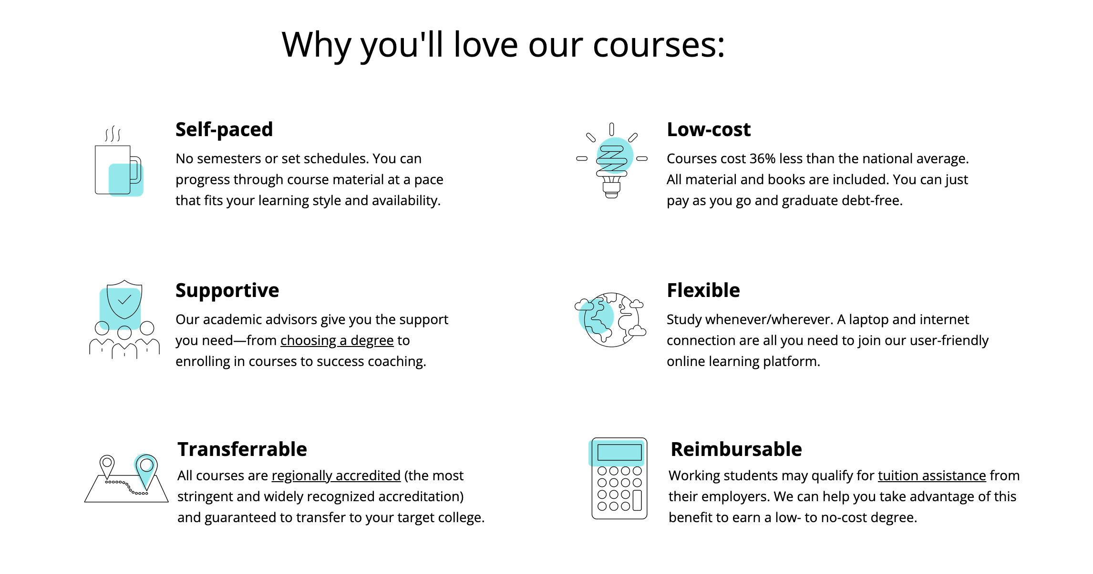
Here's why GED® learners succeed in our program

Slide 26
A new tool in the learner's bag
Traditional Remedial College Education
Hybrid Remedial Education through Pearson
5 courses +/-
7-9 College Credits
Campus and Online
2-4 Semesters
Books sometimes included
Pell eligible
Transfer via local articulation
Placement exams required
3 courses
9 College Credits
Online
1-3 Semesters
Books included
Academic Success Coach
Transfer support to 2,000+ colleges
Optional Tutoring available

Slide 27

Start with Thinking Mathematically
Thinking Mathematically
This applied mathematics course builds a foundation in problem solving, mathematical modeling, and data analysis. Emphasis is placed on the applicability of mathematics to real-world situations. Topics include algebra- and geometry-based problem solving, set theory, logic, the history of number systems, applications of functions in a variety of fields to include finance, health care, and insurance, probability and statistics, graph theory, and voting theory.
Online
3 Credit Hours
$150* (limited pilot pricing)
Monthly Cohorts

Slide 28
How can you support Graduates?
Bridge courses, financial aid, persistence!

Slide 29
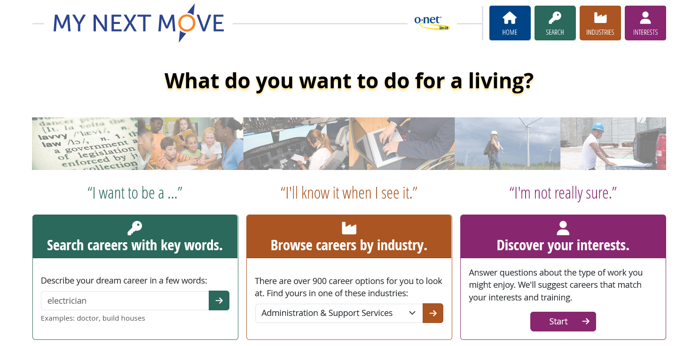
Linked resource provided at the end
Notes:
Most learners will choose education hoping it will lead to something OR have no clue how to connect their interests to jobs

Slide 30
Foster Grit
Consciously seek out challenges, no matter how large or small, and learn to over come them.
Reframe ‘failures’ from defining identity to temporary hardship for growth
Work toward things you care about and are meaningful so that you remain loyal to it
Understand that your circumstances will never be ideal but you can influence them
Discover intrinsic motivations and regularly remind yourself why you are doing something
*Additional resources provided at the end

Slide 31



Study Habits
Support
Distraction
Schedule
Learners rarely have the requisite techniques to effectively consume, understand and retain large amounts of new information
Learners persist at 2x the rate of their peers when then have at least 1 advocate outside of the classroom that they regularly connect with.
Coach, mentor, peer, tutor, family, other.
Phones are the silent study assassin.
(see research at end of deck)
The most referenced reason students indicate for stopping is insufficient time in their schedule.
Better access, study schedule, and prioritization
Notes:
Studies show that more often than not, students will turn to a friend or social media who are least equipped to provide effective support and are least likely to turn to teachers who are best equipped/most effective. As a GED educator, you are the single best support advocate in their life.

Slide 32

$1,750,000,000
In student loan debt
Forbes Advisor 2023
Notes:
According to Complete College America, the debt is significantly skewed to the 9th/10th semester. These issues are fundamentally caused by poor planning and research

Slide 33
FAFSA Mistake #1
Myth
Pell is there as long as I need it.
Reality
Pell is limited to 8 semesters throughout a learner’s lifetime.

Slide 34
FAFSA Mistake #2
Myth
I will get $7300 each year.
Reality
Pell grant award is unique to the household income of the learner and is prorated based on learner course load and is applied for annually.

Slide 35
FAFSA Mistake #3
Myth
Federal Aid doesn’t have to be paid back.
Reality
More loans are issued through Federal Aid than any other source.

Slide 36

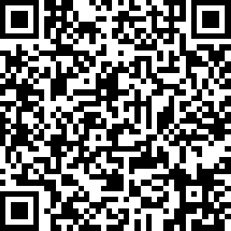
Questions?
Victor Fitzjarrald
Sr. Product Manager, GED Testing Service
Victor.Fitzjarrald@ged.com
Session Survey Link
Notes:
Demographic Extracts:
15% ages 16-17, 25% ages 18-19, 22% ages 20-24, 22% ages 25-34, 17% ages 35+
8% middle school or less, 13% 9th grade, 22% 10th Grade, 23% 11th Grade, 25% 12th Grade
40% use adult ed classes, 17% use GEDReady, 14% use Books, 10% online courses.

Slide 37

Session Survey
Your feedback is important. Please scan the QR code below to rate this session.

Slide 38
Resources I Recommend
Playbooks by CharacterLAB
Student Motivation – Digital Promise
Grit by Angela Duckworth & Ted Talk
MyNextMove.org – O*net
Do Hard Things – Steve Magness
Federal Aid Estimator
Free Financial Literacy Course – Kahn Academy
Free College Admissions Course – Kahn Academy

Slide 39
Research I am Reading
Most comprehensive study of the impact of co-requisite course models in California – UC Davis
State of Higher Education – Lumina Foundation
Impact on Attention and Academic Performance – Lepp, A., Barkley, J. E., & Karpinski, A. C.
Smart Phones and Cognition – Temple University
Multi-tasking and Cognitive Load – Kuznekoff, J. H., & Titsworth, S
What almost 150 studies say about how to motivate students – Hechinger
No Room for Doubt – Complete College America
4 Year Myth – Complete College America

Slide 40


How can GED grads get free college advising?

Slide 41
