Slide 1
All About Accommodations
Debbie Bergtholdt
August 4, 2025
GED® and GED Testing Service® are registered trademarks of the American Council on Education (“ACE”). They may not be used or reproduced without the express written permission of ACE or GED Testing Service LLC. The GED® and GED Testing Service® brands are administered by GED Testing Service LLC under license from ACE.

Slide 2

Agenda
Overview
Disability categories
Accommodation process
Documentation requirements
Best way to assist
Questions

Slide 3




Accommodations Overview
Purpose of Accommodations
Not a Guarantee of improvement
Individualized Consideration
Appropriate Documentation

Slide 4






Categories of Disabilities
Learning and Other Cognitive Disabilities Documentation within the last 5 years | Attention Deficit Hyperactivity Disorder Documentation within the last 5 years | Psychological and Psychiatric Disorders Documentation within the last 1 year | Physical Disorders and Chronic Health Conditions Documentation within the last 1 year

Slide 5

Important Reminder
Effective August 1, 2023, accommodation approvals are valid for 2 years.
(some exceptions apply)

Slide 6

What is NOT considered a disability?
ESL (English as Second Language)
“Slow Learner”
Active substance abuser
Test Anxiety
Homemade diagnoses

Slide 7
Requesting Accommodations
Create an account at GED.com
Click yes to the question about accommodations (modified testing)
Create an account in the GED Accommodations Request System
Only click the activation link once
Contact accommodations@ged.com with questions/concerns

Slide 8

Reader/
recorder
Extra Time
Separate Room
Extra “stop-the-clock” breaks
Commonly Requested Accommodations

Slide 9

Documentation Guidelines
Review documentation guidelines:
https://ged.com/about_test/accommodations/

Slide 10

Accommodation Request Volume
Year | Total Requests | Approved/Partial Approval | Incomplete | Denied
Jan-June 2025 | 3733 | 3239 | 466 | 28
2024 | 7621 | 6300 | 1278 | 43
2023 | 6446 | 5315 | 1108 | 23
2025 average turnaround time days 17.2

Slide 11
Accommodation System Features
Online Request System
Candidates request accommodations online. Starts with them clicking “yes” to the accommodation question on GED.com
Web Scheduling
Candidates with approvals of extra time, breaks and other things that do not require manual intervention are directed to schedule online.

Slide 12
Scheduling Information
The determination letter will have scheduling instructions.
Separate room approvals require a call back.
Approvals of reader and recorder require 8 business day lead and a call back.
If there is no answer when the coordinator calls back and they are unable to leave a message, an email will be sent to the candidate's email.
If the advocate should receive the call back, tell the scheduling agent the name and phone number to call.
If a message is left with an appointment offer, it is only for 2 days. After the two days, the candidate must call again.
Candidates and advocates should not call test centers directly.

Slide 13




Assistive Technology
Universal Access
features
Adaptive
equipment
Magnification
JAWS

Slide 14



Emerging Trends in Accommodations and Accessibility
Accommodation vs Fundamental Alteration
Accommodations vs Security
Non-standard requests

Slide 15

Accommodation Review Process
Who reviews requests?
How are determinations made?
Consider all documentation
Continual calibration
Written explanations

Slide 16




Outer Limits of Accommodations
Unlimited time
The accommodation cannot be so extreme that test validity is compromised
Waiving a portion of the test
The accommodation cannot fundamentally alter the test’s purpose
Administer medical care
The accommodation cannot jeopardize test security or the safety of staff/others

Slide 17
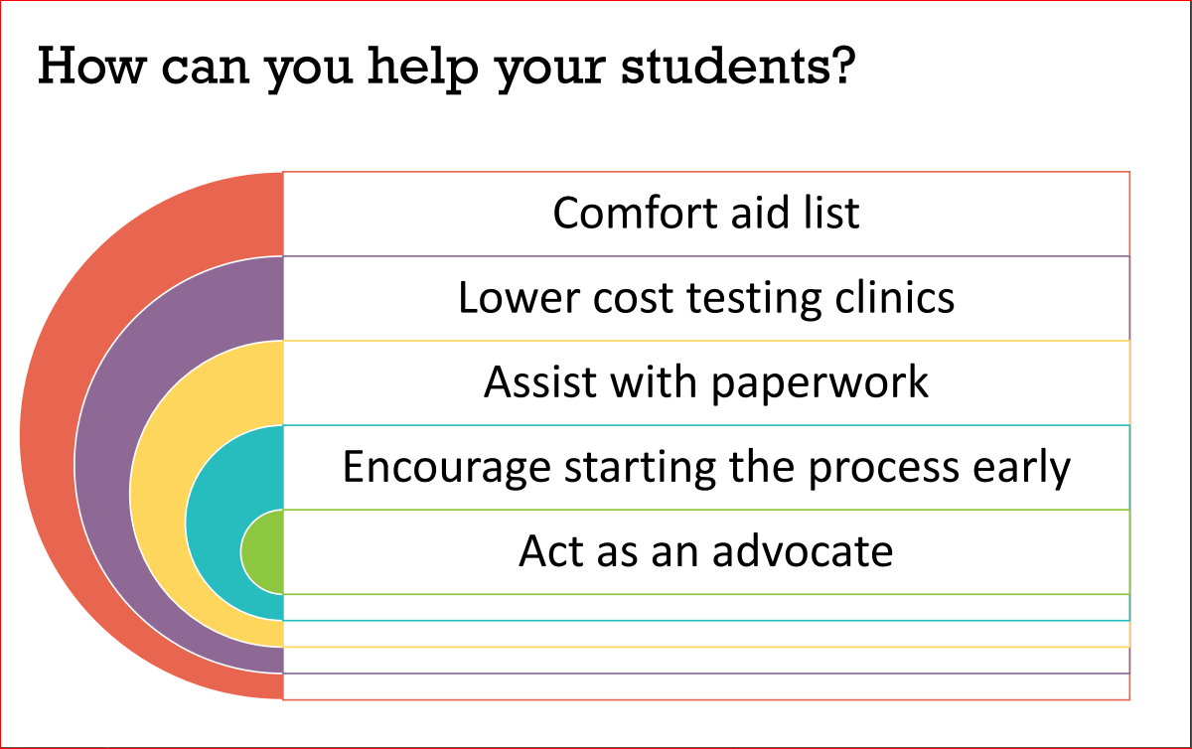

Slide 18

Resources on the Accommodation Page
Frequently Asked Questions
Lower-cost Testing Clinics in the United States
Personal Items and Minor Modifications
Questions? Email accommodations@GED.com

Slide 19

Questions?
Thank you for the work you do to support GED candidates. One person can indeed make a profound difference!

Slide 20

Contact Information
Debbie Bergtholdt
Manager, Accommodations
Debbie.Bergtholdt@pearson.com
accommodations@ged.com

Slide 21

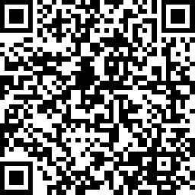
Session Survey
Your feedback is important. Please scan the QR code below to rate this session.
QR CODE PLACEHOLDER

